Slide 1

Password Strength Tester
By Cole clifford

Slide 2
Long-term goal and major application
Weak passwords are the cause for over 80% of organizational data breaches.
Educates users about password security and empowers them to create stronger, more secure passwords.
Helps users improve their password strength to prevent unauthorized access. Empowers businesses to assess and enhance the password security of their employees.

Slide 3
Key functions and challenging modules
Core Features
Password entropy calculation using mathematical methods.
Measures how random and unpredictable a password is.
Integration with “Have I Been Pwned” API to detect breached passwords.
Real-time feedback on password strength.
Random strong passwords generated with a copy feature.
Challenges
Calculating entropy and integration of the API requests.

Slide 4
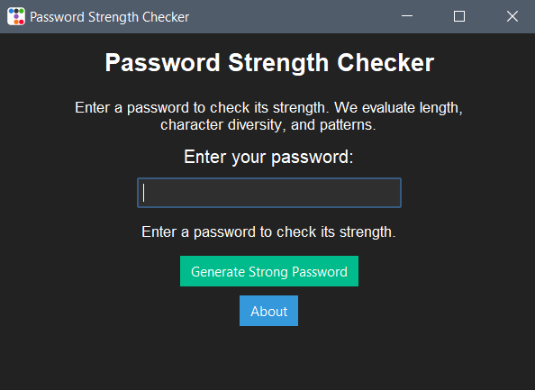
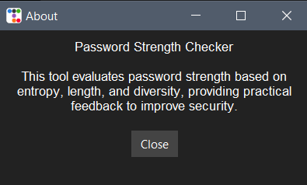
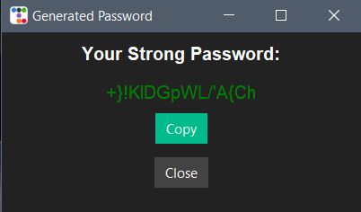
What the User Sees

Slide 5
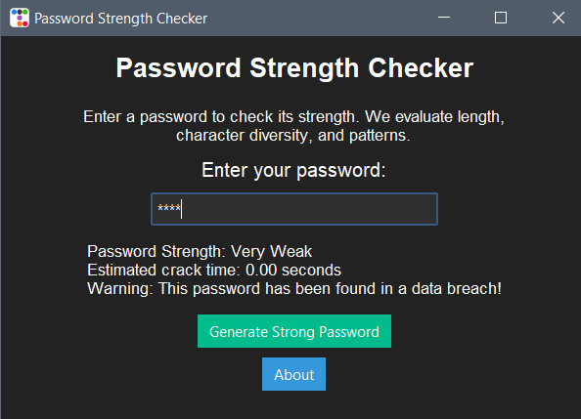
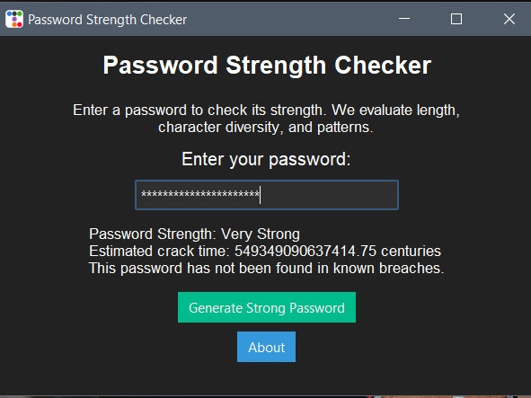
Password Checker in Action

Slide 6
Summary
Provides a user-friendly tool for evaluating password strength and educating about security best practices.
Empowers individuals and businesses to protect sensitive information from potential breaches.
Promotes awareness and adoption of strong password habits for long-term cybersecurity.

Slide 7
References
Blanton, S. (2024, December 20). 50+ Password Statistics & Trends to know in 2024. JumpCloud. https://jumpcloud.com/blog/password-statistics-trends#:~:text=Editor’s%20Picks:%20Password%20Statistics,tens%20and%20hundreds%20of%20millions.

